Slide 1
Bucket-Sort and Radix-Sort
Presentation for use with the textbook Data Structures and Algorithms in Java, 6th edition, by M. T. Goodrich, R. Tamassia, and M. H. Goldwasser, Wiley, 2014
12.3.2
1, c
3, a
3, b
7, d
7, g
7, e
∅
∅
∅
∅
∅
∅
∅
B
0
1
2
3
4
5
6
7
8
9

Slide 2
Bucket-Sort
12.3.2.x

Slide 3
Bucket-Sort 1
Let S be a sequence of n (key, element) items with keys in the range [0, N − 1]
Bucket-sort uses the keys as indices into an auxiliary array B of sequences (buckets)
Phase 1: Empty sequence S by moving each entry (k, o) into its bucket B[k]
Phase 2: For i = 0, …, N − 1, move the entries of bucket B[i] to the end of sequence S
Analysis:
Phase 1 takes O(n) time
Phase 2 takes O(n + N) time
Bucket-sort takes O(n + N) time

Slide 4
Bucket-Sort 2
^{Algorithm bucketSort(S):}
Input: Sequence S of entries with integer keys in the range [0, N − 1] Output: Sequence S sorted in nondecreasing order of the keys
let B be an array of N sequences, each of which is initially empty
^{for each entry e in S do}
^{k = the key of e}
^{remove e from S}
insert e at the end of bucket B[k]
^{for i = 0 to N−1 do}
^{for each entry e in B[i] do}
^{remove e from B[i]} ^{insert e at the end of S}

Slide 5
Example
Key range [0, 9]
7, d
1, c
3, a
7, g
3, b
7, e
Phase 1
1, c
3, a
3, b
7, d
7, g
7, e
B
0
1
2
3
4
5
6
7
8
9
∅
∅
∅
∅
∅
∅
∅
Phase 2
1, c
3, a
3, b
7, d
7, g
7, e

Slide 6
Bucket-Sort Properties and Extensions 1
Key-type Property
The keys are used as indices into an array and cannot be arbitrary objects
No external comparator
Stable Sort Property
The relative order of any two items with the same key is preserved after the execution of the algorithm

Slide 7
Bucket-Sort Properties and Extensions 2
Extensions
Integer keys in the range [a, b]
Put entry (k, o) into bucket B[k − a]
String keys from a set D of possible strings, where D has constant size (e.g., names of the 50 U.S. states)
Sort D and compute the rank r(k) of each string k of D in the sorted sequence
Put entry (k, o) into bucket B[r(k)]

Slide 8
Lexicographic Sort
12.3.2.x

Slide 9
Lexicographic Order
A d-tuple is a sequence of d keys (k₁, k₂, …, k_{d}), where key k_{i} is said to be the i-th dimension of the tuple
Example:
The Cartesian coordinates of a point in space are a 3-tuple
The lexicographic order of two d-tuples is recursively defined as follows
(x₁, x₂, …, x_{d}) < (y₁, y₂, …, y_{d}) ⇔ x₁ < y₁ ∨ x₁ = y₁ ∧ (x₂, …, x_{d}) < (y₂, …, y_{d})
I.e., the tuples are compared by the first dimension, then by the second dimension, etc.

Slide 10
Lexicographic-Sort 1
Let C_{i} be the comparator that compares two tuples by their i-th dimension
Let stableSort(S, C) be a stable sorting algorithm that uses comparator C
Lexicographic-sort sorts a sequence of d-tuples in lexicographic order by executing d times algorithm stableSort, one per dimension
Lexicographic-sort runs in O(dT(n)) time, where T(n) is the running time of stableSort

Slide 11
Lexicographic-Sort 2
Algorithm lexicographicSort(S)
Input sequence S of d-tuples Output sequence S sorted in lexicographic order
for i ← d downto 1
stableSort(S, C_{i})
Example:
(7,4,6) (5,1,5) (2,4,6) (2, 1, 4) (3, 2, 4)
(2, 1, 4) (3, 2, 4) (5,1,5) (7,4,6) (2,4,6)
(2, 1, 4) (5,1,5) (3, 2, 4) (7,4,6) (2,4,6)
(2, 1, 4) (2,4,6) (3, 2, 4) (5,1,5) (7,4,6)

Slide 12
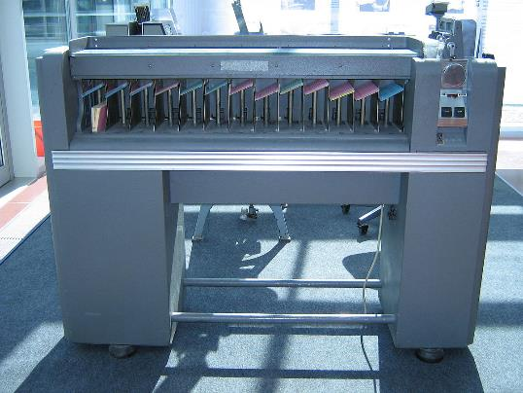
Punch-Card Sorting Machine
This Photo by Unknown Author is licensed under CC BY-SA

Slide 13
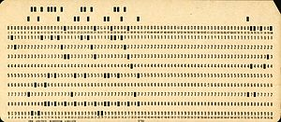

Sorting Punched Cards
This Photo by Unknown Author is licensed under CC BY-SA
This Photo by Unknown Author is licensed under CC BY-SA
First, sort by column 80
(sort by columns 79 down to 74)
Sort by column 73

Slide 14
Radix-Sort
12.3.2.x

Slide 15
Radix-Sort
Radix-sort is a specialization of lexicographic-sort that uses bucket-sort as the stable sorting algorithm in each dimension
Radix-sort is applicable to tuples where the keys in each dimension i are integers in the range [0, N − 1]
Radix-sort runs in time O(d( n + N))
Algorithm radixSort(S, N)
Input sequence S of d-tuples such
that (0, …, 0) ≤ (x₁, …, x_{d}) and (x₁, …, x_{d}) ≤ (N − 1, …, N − 1) for each tuple (x₁, …, x_{d}) in S Output sequence S sorted in lexicographic order
for i ← d downto 1
bucketSort(S, N)

Slide 16
Radix-Sort for Binary Numbers
Consider a sequence of n b-bit integers x = x_{b − 1} … x₁x₀
We represent each element as a b-tuple of integers in the range [0, 1] and apply radix-sort with N = 2
This application of the radix-sort algorithm runs in O(bn) time
For example, we can sort a sequence of 32-bit integers in linear time
Algorithm binaryRadixSort(S)
Input sequence S of b-bit integers Output sequence S sorted
replace each element x of S with the item (0, x)
for i ← 0 to b − 1
replace the key k of each item (k, x) of S with bit x_{i} of x
bucketSort(S, 2)

Slide 17
Example
Sorting a sequence of 4-bit integers
1001
0010
1001
1001
0001
0010
1110
1101
0001
0010
1101
1001
0001
0010
1001
0001
1101
0010
1101
1101
1110
0001
1110
1110
1110

